Slide 1
Friends of Canvey Lake
Art Project
2023

Slide 2
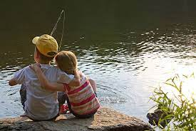
Let’s take a look at our lake!

Slide 3

Friends of Canvey lake Art project 2023
https://www.canveyisland.org/places-3/places-2-3/lakeside/canvey-lake-june-2020
Watch this Arial Drone Vision video ‘Flight’ by Chris Little.

Slide 4
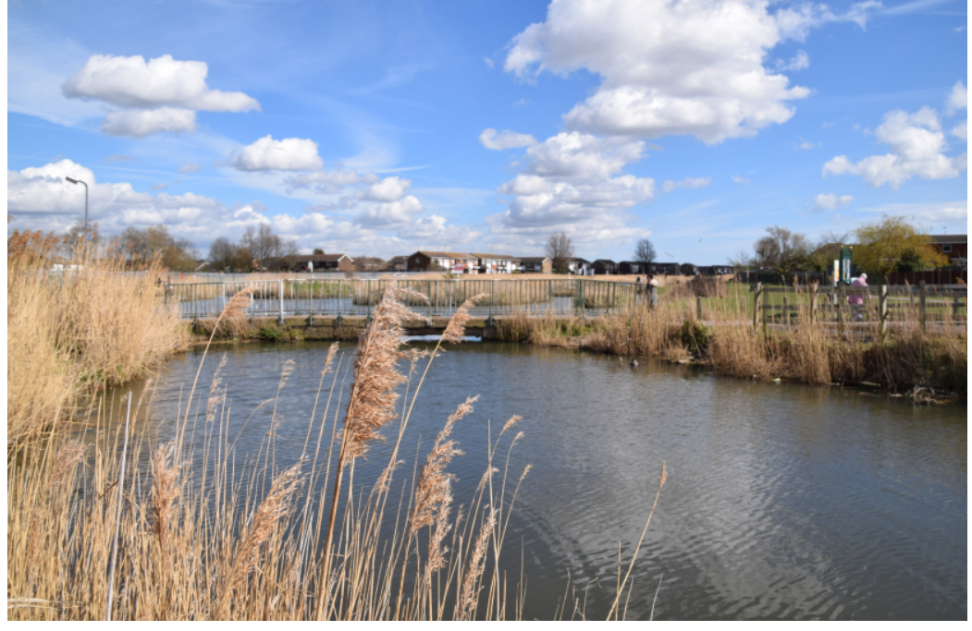
Friends of Canvey lake Art project 2023
Image from: https://www.canveyisland.org/abc-2/wildlife/by-the-lake-in-lockdown

Slide 5
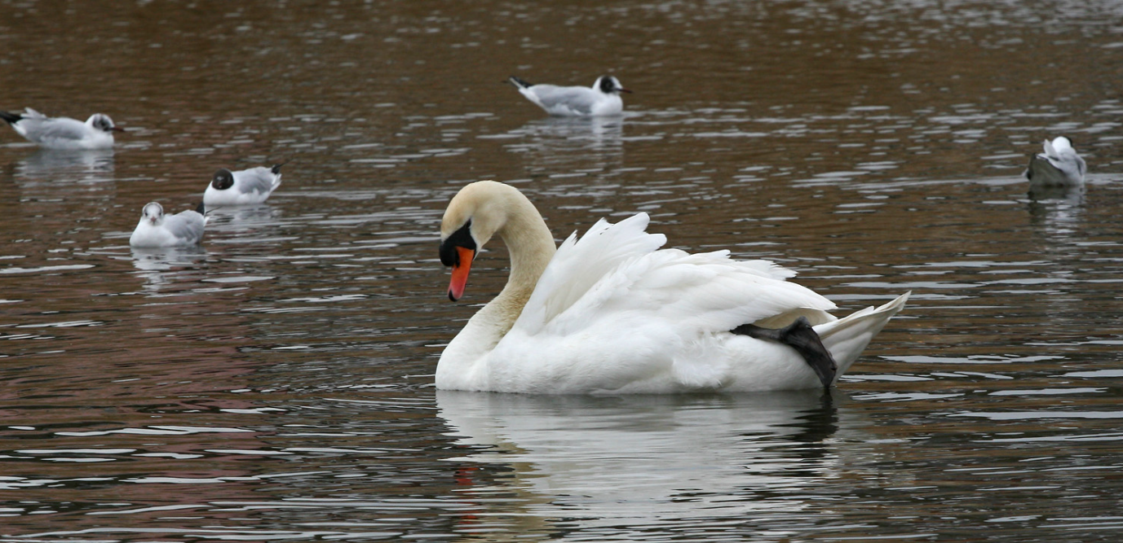
Friends of Canvey lake Art project 2023
Image from: https://www.canveyisland.org/abc-2/wildlife/by-the-lake-in-lockdown

Slide 6
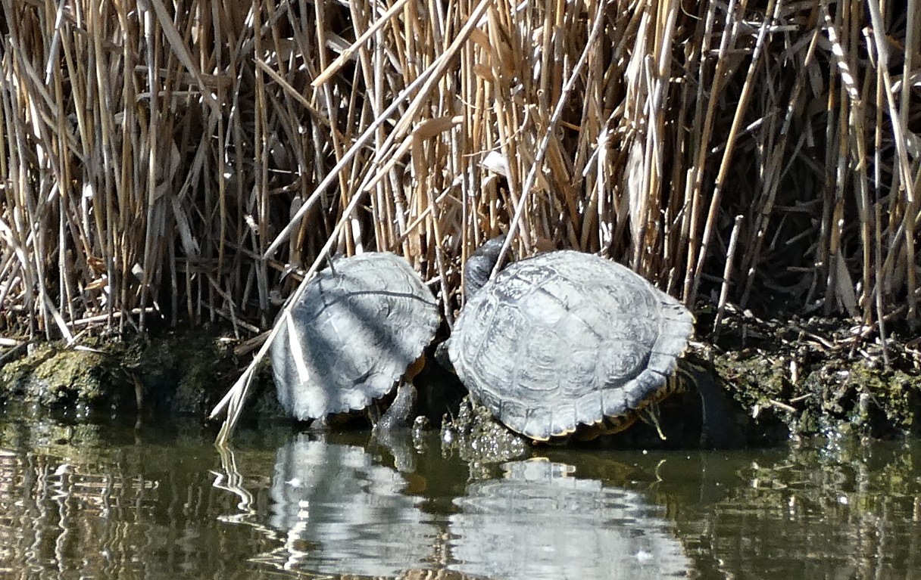
Friends of Canvey lake Art project 2023
Image from: https://www.canveyisland.org/abc-2/wildlife/by-the-lake-in-lockdown

Slide 7

Friends of Canvey lake Art project 2023
You are also friends of Canvey Lake. Canvey lake belongs to all of us!
What do you love and what would you change?

Slide 8
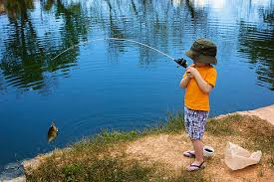
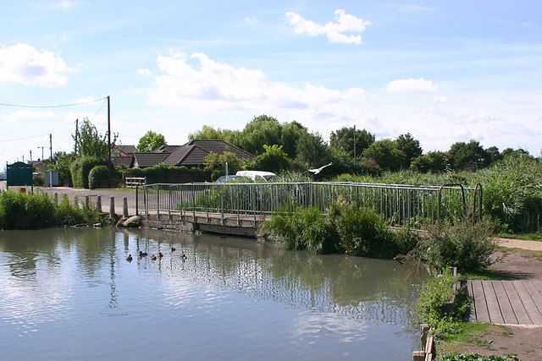
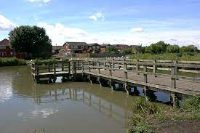
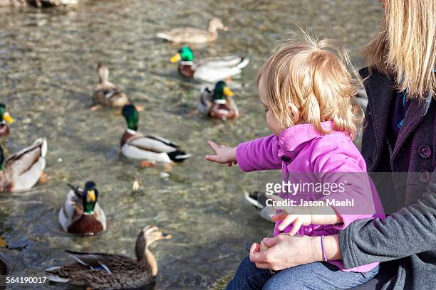
Friends of Canvey lake Art project 2023
What are your memories of the lake?

Slide 9

Friends of Canvey lake Art project 2023
Do you have any photos of your lovely memories?
You can place them into the memory cloud.
If you do not have any photos, draw a picture of your favourite time at the lake.
Write a sentence about what you loved so much.

Slide 10
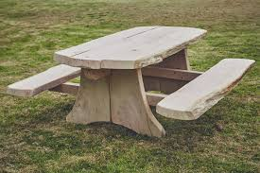
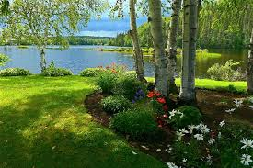
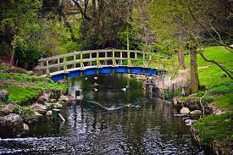
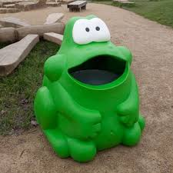
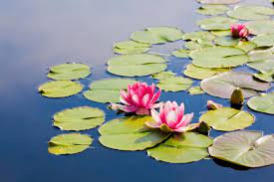
Friends of Canvey lake Art project 2023
Let’s design!
How can we make it look cleaner?
What can we add?
What needs improving?

Slide 11
Friends of Canvey lake Art project 2023
Let’s create!
Create a whole class collage/picture of how you would like the lake to look!

Slide 12
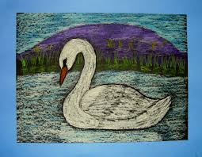
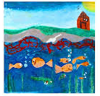
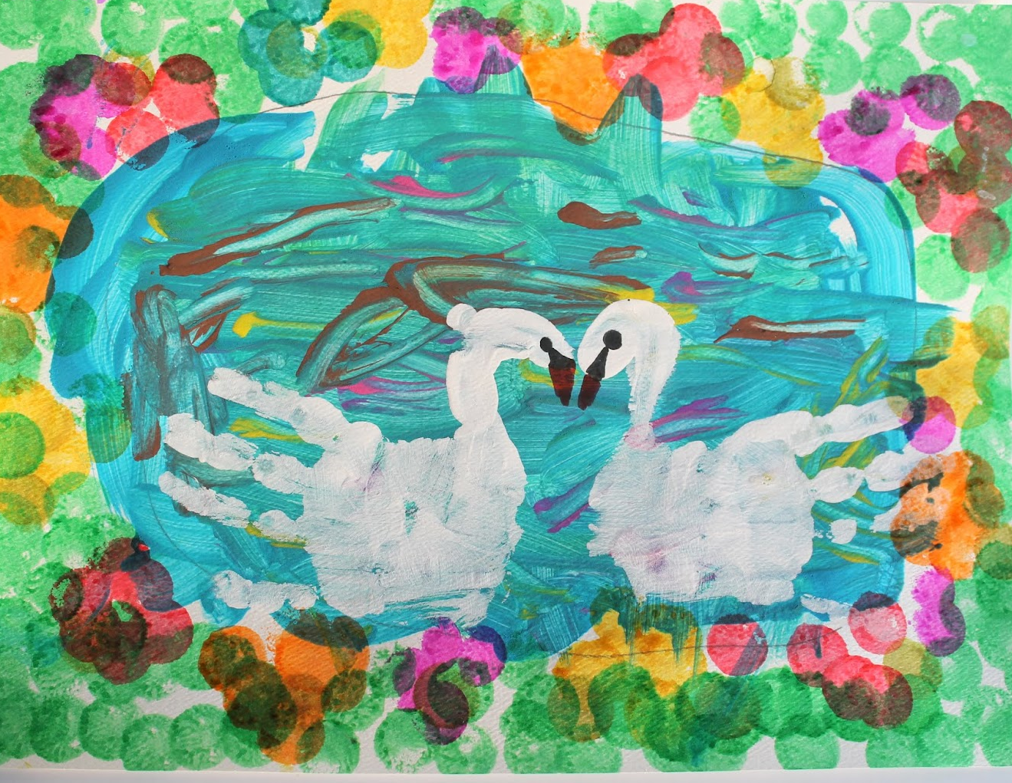
Friends of Canvey lake Art project 2023
Create your own picture of your favourite wildlife!
You can cut these out and add them to your whole class
BIG picture! You can use mixed media.

Slide 13
Thank you!
for sharing your ideas and being a part of our friends of Canvey Lake family!

